Slide 1
Exploring the Feasibility of Implementing a Cash-Flow Reconciliation Approach in the Consumer Expenditure Interview Survey
Scott Fricker
Brandon Kopp
Nhien To
Bureau of Labor Statistics
December 3, 2011

Slide 2
Overview
Background
Consumer Expenditure Quarterly (CEQ) Interview Survey
Concerns about underreporting in CEQ
Balance edit / Cash-flow reconciliation
Study Objectives and Methods
Key Findings
Discussion of Study Limitations & Implications

Slide 3
Background – CE Overview
Principle Objective
Collect information on buying habits of American consumers
Data Uses
Revising the expenditure weights for the CPI every 2 years
Analysis of expenditure patterns by characteristics
Economic research
Market research
Survey Design
Interview Survey (CEQ)
Diary Survey (CED)

Slide 4
Background – CEQ
CEQ Design
Each consumer unit (CU) is interviewed every 3 months over 5 calendar quarters
Designed to capture expenditures that respondents can reasonably recall for a period of 3 months or longer
Large purchases (e.g., major appliances, vehicles)
Regular expenses (e.g., rent, utilities)
Covers 20 expenditure categories (95% of expenditures)
Information on income, liabilities, and change in assets collected in 2nd and 5th interview
Data Collection
Mode: In-person (65%); Phone (35%)
Information Booklet (i.e., flashcards) provides examples
Average interview takes 60 minutes

Slide 5
Background – CEQ cont.
CEQ – Challenges
Detailed questions
What did you buy? For whom? How many? When? How much did it cost? Include sales tax?
Long interview
Impacts on respondent burden
Concerns about underreporting
Gieseman (1987); Bosworth, Burtless, & Sabelhaus (1991); Garner et al. (2006); Shields & To (2005)
Due to recall errors, panel conditioning, respondent fatigue, etc.

Slide 6
Background – Cash Flow Reconciliation
Cash Flow Reconciliation
Following primary data-collection, respondents given chance to review and revise answers
American Life Panel (ALP), RAND
Web-based survey, monthly/quarterly reference period, n≈2,500
Global questions on 25 expenditure categories
Respondents shown summary (‘reconciliation’) screen and given chance to correct items
Goal: reduce item nonresponse and outliers

Slide 7
Background – Balance Edit, cont.
Balance Edit Check
Survey of Household Spending (SHS), Stats Canada
Detailed questions on expenditures, income, assets, liabilities
In-person survey (n≈16,700), CAPI
Annual reference period
Balance Edit: when expenditures differ from income/assets by 15%+ (20%+ for lower income HH), interviewer asks up to 16 follow-up probes
Goal: bring exp/income-assets w/in 10% or less (15% or less)

Slide 8
Background – Balance Edit, cont.

Slide 9
Background – Balance Edit, cont.
Impact of These Methods
Reconciliation in ALP
Respondents corrected about 2-3% of reports per interview wave
Significant reductions in item nonresponse and frequency/magnitude of outliers (Hurd & Rohwedder, 2010)
Balance Edit in SHS
Large number of households were ‘out of balance’ (29% in 2006)
Most of changes respondents made were to income & asset reports
Evidence that the balance edit reduced income underreporting for lowest-income households (Brzozowksi & Crossley, 2011)
CE Methods Workshop
December 2010, expert panel recommendation

Slide 10
Study Objectives
Limited empirical work suggests balance edit can improve survey quality
No empirical work on cognitive underpinnings of effect
Present study goals:
Conduct small-scale, lab-based study to examine:
How respondents interpret the task?
What changes they make (if any) to their reports?
Respondents’ reactions to balance edit probes, seeing HH spending totals, etc.?
Potential impact on overall survey quality?
Viewed as initial feasibility test to inform future CE redesign research and decisions

Slide 11
Study Methods
Overview of Study Procedures
19 lab participants administered modified CE survey (CAPI)
Main survey
Items: HH demographics; expenditures (covering all CE topics); income; changes in assets and liabilities. (w/ Information Booklet)
Balance edit
Triggered if spending deviated 15%+ from income/assets/liabilities
Hybrid of SHS and ALP approaches – 3 phases:
Phase 1: R shown graph depicting ratio of income-to-spending
Phase 2: R shown summary screen – review & revise
Phase 3: R asked additional probes
Stopped when income-spending within 10%
Respondent debriefing
Assess R reactions to survey & balance edit procedure, perceptions of accuracy, sources of confusion, etc.

Slide 12
Study Methods, cont.
Procedural Caveats
Study is qualitative and exploratory
Design considerations affected study scope and methods:
Potential impacts on R burden
R review/revision of large set of CEQ items would be impractical
Study need to develop instrument for real-time balancing checks
Significant departures from CEQ:
Use of ‘global’ expenditure questions - asked R to report their total HH spending in each CE section category (not detailed items)
Shorter interview: 25-30 minutes (not 60 minutes)
Reference period
Expenditures – 1 month (not 3 months)
Changes in assets and liabilities – 1 month (not 1 year)
Income – flexible (not only 1 year)

Slide 13
Study Methods, cont.
Balance Edit Calculation
Ratio of income-to-spending
[Income – Ch-Assets + Ch-Liabilities] / Spending
Ratio < 1.0: HH spent more than income
Ratio > 1.0: HH spent less than income

Slide 14
Balance Edit: Phase 1 Figure

Slide 15
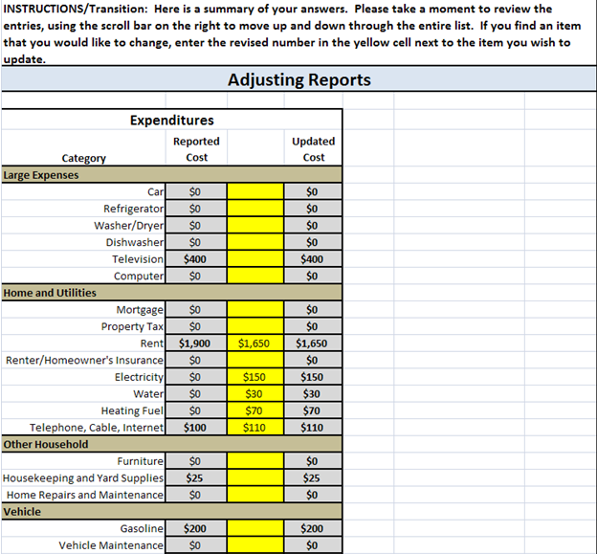
Balance Edit: Phase 2 Summary Screen

Slide 16
Balance Edit: Phase 3 Probes

Slide 17
Study Methods, cont.
Data Quality Indicators Used in this Study
No direct measure of ‘truth’
Used the following indirect measures:
Change in income-to-spending ratio (closer to 1.0 is better)
Level of reporting (‘more is better’)
Qualitative responses from respondent debriefing

Slide 18
Study Findings
Effect of Balance Edit on Income-to-Spending Ratios
Only 1 R obtained balance w/out need for edit
2 Rs obtained balance after review/revise; 2 after BE probes
14 of 19 remained unbalanced, but there was a general positive impact of edit:
E.g., Extreme deviations (>20%) cut in half
Nonetheless, for the 13 R whose balance improved, the average absolute deviation was 42% from balance (1.0)

Slide 19
Study Findings, cont.
Effect of Balance Edit on Reporting Levels
Phase 2 - Review/Revise:
Mean change in reported expenditures: 6.2%
Mean change in reported income: 45.3%
Phase 3 - BE Probes:
Mean change in reported expenditures: 19.6%
Mean change in reported income: 42.7%

Slide 20
Study Findings, cont.
Debriefing – Reactions to Balance Edit
Respondent burden
Rs’ estimates of survey length longer than actual length
Positive ratings of appropriateness of survey length and perceived burden
“Not at all burdensome.” “… very interesting “
Comprehension of ratio chart and purpose of balance edit
Group 1: initial confusion (n=3)
Didn’t understand chart or concept of income net assets & liabiities
Group 2: emotional response (n=5)
Surprise/discomfort w/ excessive spending
Inference of judgment/error – “I felt a little stupid”
Inference of mistrust – “I was a little frustrated because I knew I was being truthful”
Group 3: understood chart/positive reactions (n=10)
Intrigued by information presented and balance-edit process

Slide 21
Study Methods, cont.
Reactions to Balance Edit, continued
R reactions related to magnitude of ratio change and final balance status
Group 1: initially reported more income than spending (no balance)
Group 2: initially reported more spending than income (no balance)
Group 3: smaller (or off-setting) changes made during edit (4/10 balanced)

Slide 22
Study Findings, cont.
Reactions to Balance Edit, continued
Phase 2: Review & Revise
Reactions and effort mixed
Some said it was ‘daunting’ or ‘chastising’ – (confronting ‘hard truths’)
Some really liked the summary table (triggered memory)
Most common adjustments related to:
Landmark events (e.g., birthdays, trips)
Proxy-related (e.g., spouses’ expenses, contributions to IRA, etc.)
A few R seemed to try to improve balance through arbitrary changes
Phase 3:
15 of 16 R who received these probes said they were clear and easy
Most common items picked up: child-care expenses & tax refunds/payments

Slide 23
Study Results Summary
18 of 19 participants initially provided reports that were sufficiently unbalanced to trigger balance edit
Balance edit improved income-to-spending ratios for 13 Rs, but only 4 achieved balance (within 10%)
Remaining unbalanced HHs were highly so
Rs’ reactions to edit process were mixed, and these were related to survey outcome/balance

Slide 24
Study Limitations
Small, convenience sample (few lower-income HHs)
Issues related to specific balance edit implementation
Explanatory language and procedures used could be refined
Use of global questions – significantly shortened interview; may have encouraged estimation strategies; may affect perceived burden

Slide 25
Final Thoughts
Efficacy of balance edit depends on survey design features (e.g. mode, length, use of global questions, etc.)
Existing CEQ protocols raise number of feasibility concerns with implementing a balance edit:
# of items / length
Study BE procedure added significantly to survey length
Potential impact on respondent burden (data quality, retention)
Programming/instrumentation complexities
35% of CEQ cases conducted by phone
No visual review/summary; less use of Information Booklet & records; interviewers less able to identify confusion or satisficing and intervene
Reference period
3-month reference period might make it more difficult to accurately report change in assets and liabilities
Much depends on future direction of CE redesign!

Slide 26
References
Bosworth, B., Burtless, G., and Sabelhaus (1991). “The Decline in Saving: Some Microeconomic Evidence.” Brookings Papers on Economic Activity, 1, p. 183-256.
Brzozowski, M., Crossley, T.F., , (2011). “Measuring the Well-being of the Poor with Income or Consumption: A Canadian Perspective.” Canadian Journal of Economics, 44, pp. 88 – 106..
Garner, Thesia I., George Janini, William Passero, Laura Paszkiewicz, and Mark Vendemia (2006), “The CE and the PCE: a comparison,” Monthly Labor Review, Vol. 129, No. 9, September, pp. 20-46 (available at: http://stats.bls.gov/opub/mlr/2006/09/art3full.pdf).
Hurd, M. and Rohwedder, S. (2010). “The Effects of the Financial Crisis and the Great Recession on American Households.” NBER Working Papers 16407, National Bureau of Economic Research.
Shields, Jennifer and Nhien To (2005), “Learning to Say No: Conditioned Underreporting in an Expenditure Survey,” Proceedings of the Section on Survey Methods Research, American Statistical Association.

Slide 27
Scott S. Fricker Office of Survey Methods Research Bureau of Labor Statistics www.bls.gov/osmr 202-691-7390 fricker.scott@bls.gov

